Slide 1
Euclidean Algorithm
How to find a greatest common divisor in several easy steps

Slide 2
Euclidean Algorithm
The well known Euclidean algorithm finds the greatest common divisor of two numbers using only elementary mathematical operations - division and subtraction

Slide 3
Euclidean Algorithm
A divisor of a number a is an integer that divides it without remainder
For example the divisors of 12 are 1, 2, 3, 4, 6 and 12
The divisors of 18 are 1, 2, 3, 6, 9 and 18.

Slide 4
Euclidean Algorithm
The greatest common divisor, or GCD, of two numbers is the largest divisor that is common to both of them.
For example GCD(12, 18) is the largest of the divisors common to both 12 and 18.

Slide 5
Euclidean Algorithm
The common divisors of 12 and 18 are 1, 2, 3 and 6.
Hence GCD(12, 18)=6.

Slide 6
Euclidean Algorithm
The Euclidean Algorithm to find GCD(a, b) relies upon replacing one of a or b with the remainder after division.
Thus the numbers we seek the GCD of are steadily becoming smaller and smaller. We stop when one of them becomes 0.

Slide 7
Euclidean Algorithm
Specifically, we assume that a is larger than b. If b is larger than a, then we swap them around so that a becomes the old b and b becomes the old a.
We then look for numbers q and r so that a=bq+r. They must have the properties that q≥0 and 0≤r<b.
In other words, we seek the largest such q.

Slide 8
Euclidean Algorithm
As examples, consider the following.
a=12, b=5; 12=5*2+2 so q=2, r=2
a=24, b=18; 24=18*1+6 so q=1, r=6
a=30, b=15; 30=15*2+0 so q=2, r=0
a=27, b=14; 27=14*1+13 so q=1, r=13
Try the ones on the next slide.

Slide 9
Euclidean Algorithm
Find q and r for the following sets of a and b. The answers are on the next slide.
a=28, b=12
a=50, b=30
a=35, b=14
a=100, b=20

Slide 10
Euclidean Algorithm
Answers
q=2, r=4
q=1, r=20
q=2, r=7
q=5, r=0

Slide 11
Euclidean Algorithm
The algorithm works in the following way.
Given a and b, we find numbers q and r so that a=bq+r.
We make sure that q is as large as possible (≥0), and 0≤r<b.
For example, if a=18, b=12, then we write 18=12*1+6.

Slide 12
Euclidean Algorithm
Actually the number q isn’t important, it is just easier to find r with it when solving problems by hand. Most software can find the remainder r without finding q.
For example the Java statement below will find r.
r=a%b;

Slide 13
Euclidean Algorithm
Once the remainder r has been found we replace a by b and b by r.
This relies on the fact that GCD(a,b)=GCD(b,r).
Hence we repeatedly find r, the remainder after a is divided by b.
Then replace a by b and b by r, and keep on in this way until r=0.

Slide 14
Euclidean Algorithm
Let us look at a graphical interpretation of the Euclidean algorithm.
Obviously if p=GCD(a,b) then p|a and p|b, that is to say p divides both a and b evenly with no remainder.

Slide 15
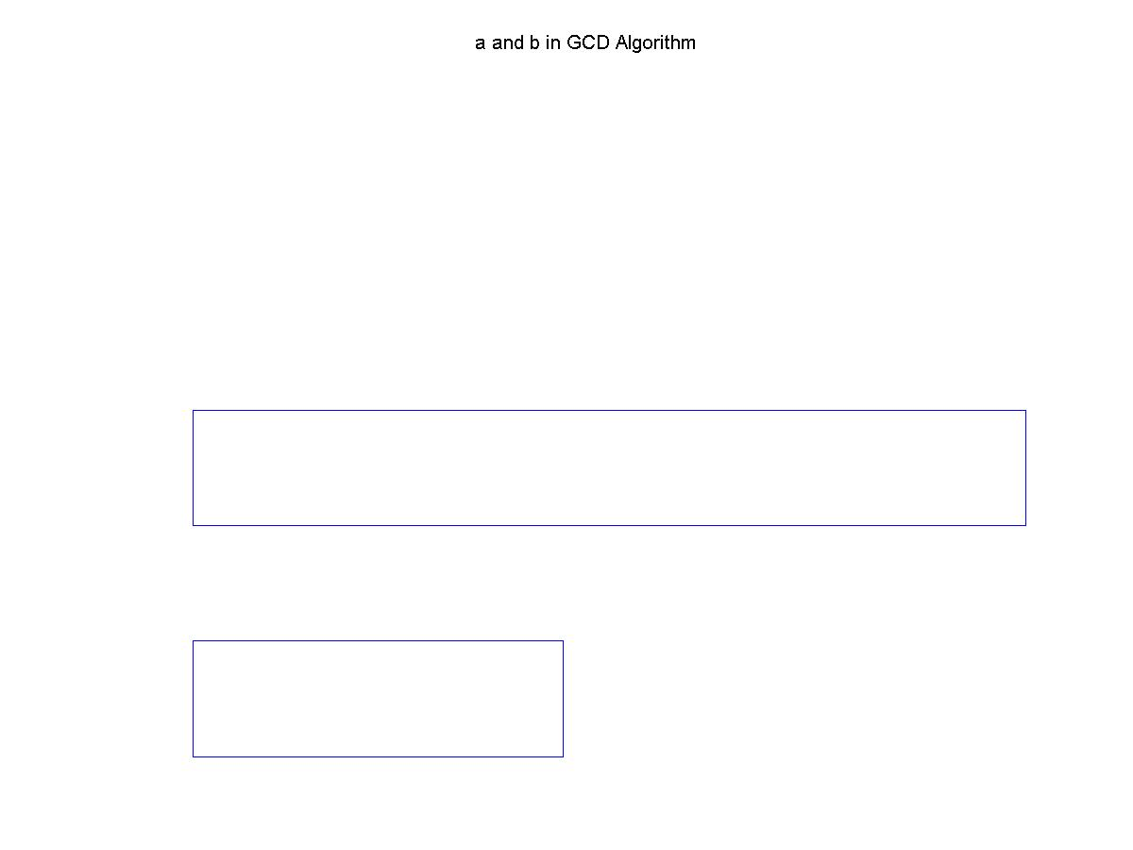
Euclidean Algorithm
Suppose a and b are represented by the lengths below.

Slide 16
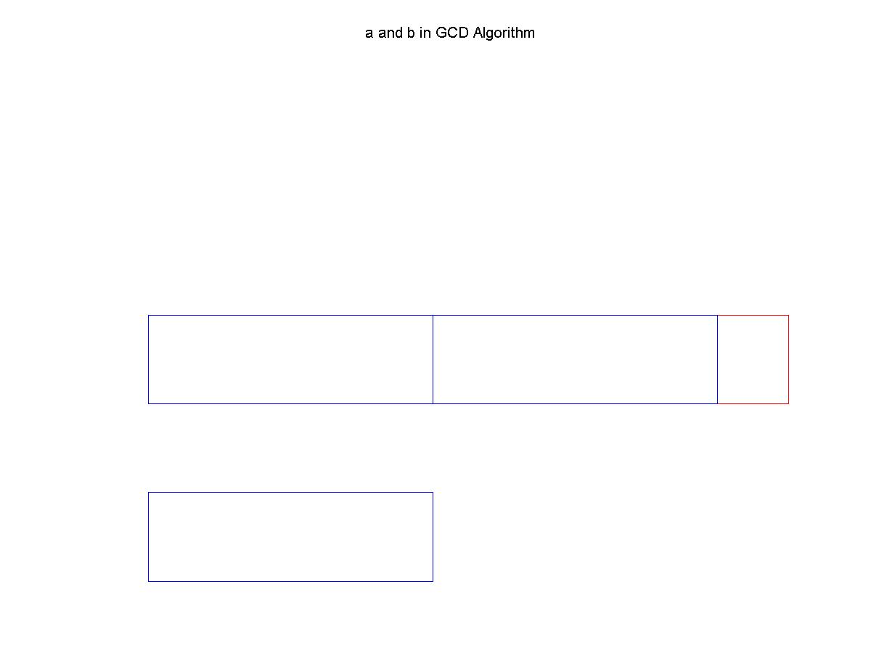
Euclidean Algorithm
Note that b does not go into a evenly, but has some small remainder.

Slide 17
Euclidean Algorithm
If p is the GCD of a and b then it divides evenly into both a and b. Hence it divides evenly into b and thus must divide evenly into both of the larger two boxes in the previous diagram.

Slide 18
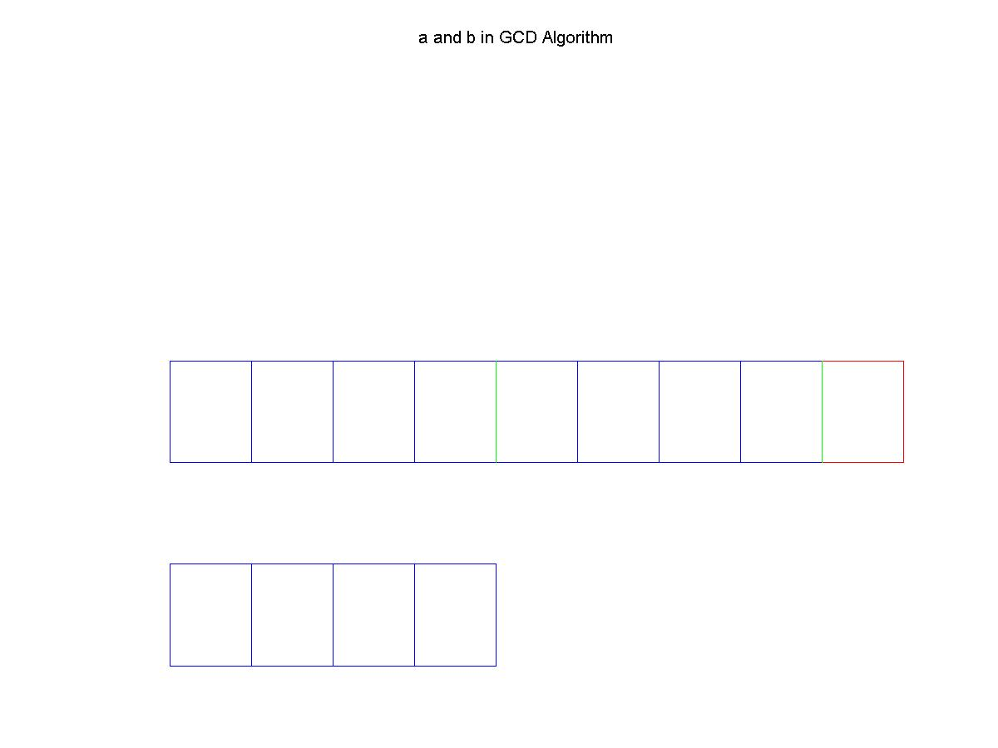
Euclidean Algorithm
Then p divides the length representing b a whole number of times, and hence the boxes in a that represent whole lengths of b.

Slide 19
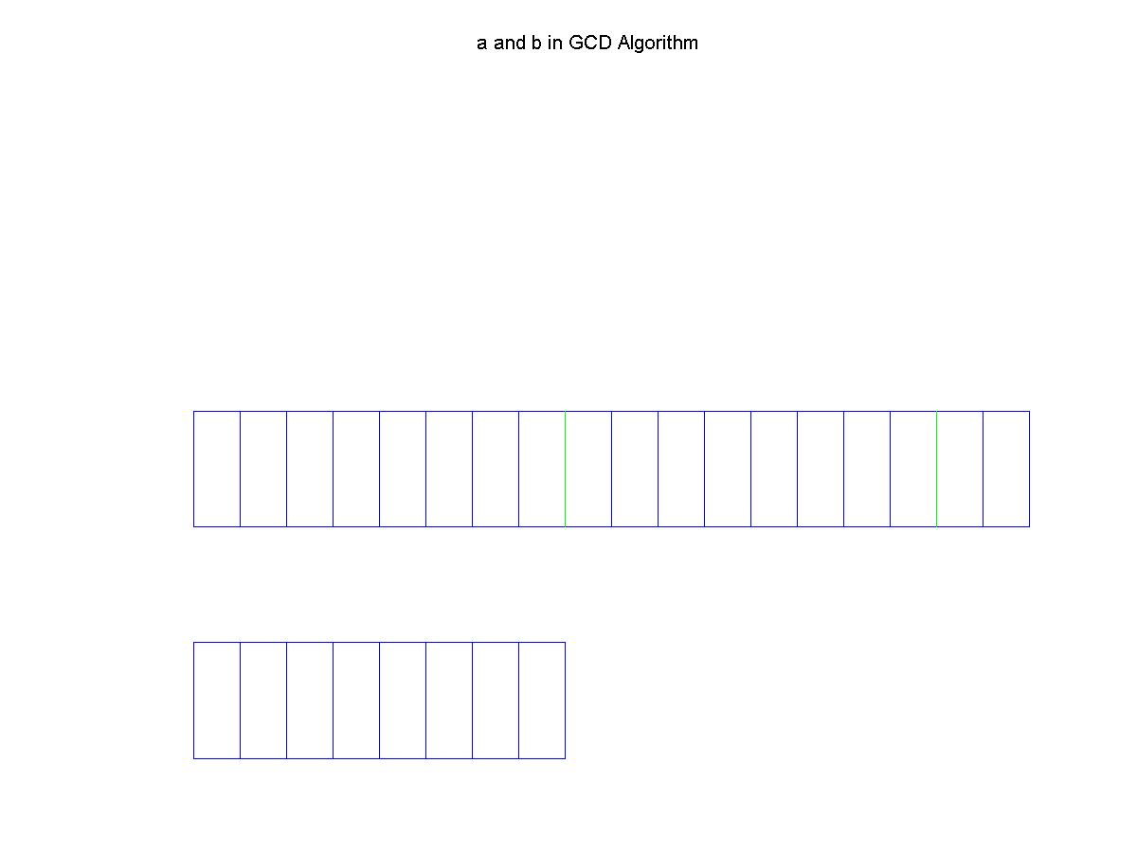
Euclidean Algorithm
Of course if p divides a evenly then it must also divide the remainder evenly. The picture below shows this.

Slide 20
Euclidean Algorithm
Hopefully it will be clear that by now any number that divides both a and b must also divide the remainder r.
The largest of these will of course be the GCD of a and b.
So GCD(a,b)=GCD(b,r).

